Slide 1
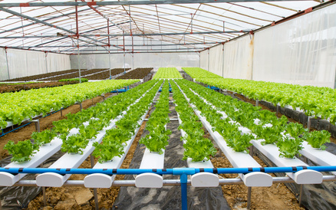
HOS 2005C PRINCIPLES OF HYDROPONICS
Dr. Javier A. Garces
Valencia College

Slide 2
Major Topics Covered
History of hydroponics.
Basic concepts and components in hydroponic production systems.
Different methods of hydroponic production.
Future of hydroponic technology.

Slide 3
History
Hanging Gardens of Babylon.
Floating Gardens of the Aztecs in Mexico.
Chinese had records of a form of hydroponic production.
Egyptian hieroglyphic records, several hundred years B.C. – growing of plants in water.
Theophrastus various experiments in crop nutrition.
Dioscorides, 1st century A.D. did botanical studies using hydroponics.

Slide 4
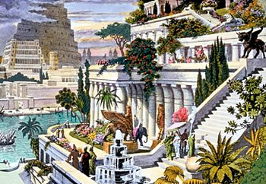
Hanging Gardens of Babylon

Slide 5
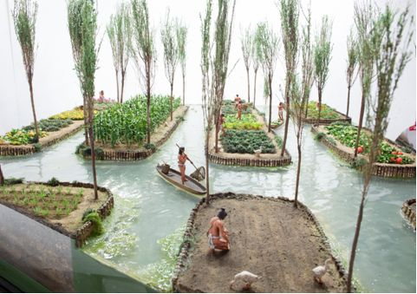
Floating Rafts of Aztecs
Notes:
Chinese also had similar systems

Slide 6
History
1600, Jan van Helmont (Belgium)
5 lb Willow shoot in tube with 200 lb of dried soil
5 yrs watering with rain water, willow shoot increased in weight by 160 lbs.
Soil lost less than 2 oz.
Concluded that plants obtain growth substances from water.
1699, John Woodword (English)
Grew plants in water with various types of soil.
Found plants grew best in water that contained most soil.
Concluded certain substances in water, derived from soil, necessary for plant growth.
Notes:
J. van Helmont
-failed to realize plants also need CO2 and O2 from air

Slide 7
History
1800’s
DeSaussure – plants made from chemical elements obtained from water, air, & soil.
Boussingault – concept of essential elements.
Sachs, Knop – “nutriculture”.
1920’s-30’s
Greenhouse industry expressed interest in “nutriculture” due to issues w/ soil.
W.F Gericke, University of CA (1930’s).
Termed “nutriculture’ systems hydroponics.
Hydro-water, ponos-labor.
Grew large variety of plants.
Notes:
Boussingault
Experiments with plants grown in sand, quartz, charcoal; added solutions of known chemical composition.
Water essential for plant growth providing H while air provides O & C
Stated plants contain N and other elements
Sachs, Knop
Plant growth by immersing roots of plants in water containing N, P, S, K, Ca, Mg
Gericke
Veg-root crops, cereal crops, fruits, ornamentals, flowers
1940’s provided food to US military in the Pacific
After WWII, US army established a 22ha project at Chofu, Japan
1950’s, commercial hydroponics in Italy, Spain, France, England, Germany, Sweden, USSR, Israel

Slide 8
History
Hydroponics – science of growing plants without the use of soil, but an inert medium, such as gravel, sand, peat, vermiculite, pumice, perlite, coco coir, sawdust, rice hulls or other substances, to which is added a nutrient solution containing all the essential elements needed by a plant for its normal growth and development.
Two principal advantages
High crop yields
Special utility in nonarable regions

Slide 9
History - Present
Development of plastics, suitable pumps, time clocks, plastic plumbing, solenoid valves, & other equipment which automates systems and brings down costs.
Large installations exist worldwide for both flowers & vegetables.
World hydroponic production has increased from 5,000-6,000 ha (12,500-15,000 ac) in the 1980’s to 20,000-25,000 ha (50,000-62,500 ac) in 2001.
Greenhouse Vegetable Production Statistics – 2011 Edition, claims worldwide hydroponics vegetable production is approximately 35,000 ha (815,000 ac)
Greenhouse hydroponic production uses soilless culture; many areas plant in soil then cover with a light-weight poly structure with drip irrigation.
Canary Islands, Spain, China, Mexico

Slide 10
History – Present
Holland – 4,600 ha (11,300 ac) of hydroponic vegetable production with sophisticated, high tech greenhouses.
Spain – has about 4,000 ha but lower-tech, poly greenhouses.
Belgium & Germany each have approximately 600 ha.
New Zealand & Australia have about 500 ha.
Australia has largest commercial hydroponic lettuce production with over 240 ha.
Hydroponic production occurring in almost every country in the world.
Arid regions of the world, hydroponic complexes combined with desalination units being developed.

Slide 11
STATISTICS – Greenhouse
COUNTRY | GREENHOUSE AREA (HA) | GREENHOUSE AREA (AC) | SOURCE
USA | 8,425 | 20,810 | US CENSUS, HORT SPEC 2010
CANADA | 2,288 | 5,651 | NA
MEXICO | 11,759 | 29,045 | SAGARPA, 2010
SPAIN | 52,170 | 128,860 | EUROSTAT, 2005
FRANCE | 9,620 | 23,761 | EUROSTAT, 2005
HOLLAND | 10,370 | 25,614 | EUROSTAT, 2005
POLAND | 7,560 | 18,673 | EUROSTAT, 2005
ITALY | 26,500 | 65,455 | EUROSTAT, 2005
GREECE | 4,670 | 11,535 | EUROSTAT, 2005
TURKEY | 33,515 | 82,782 | TURKSTAT, 2007
CHINA | 2,760,000 | 6,817,200 | YANG, 2011
S. KOREA | 57,444 | 141,887 | LEE, 2011
JAPAN | 49,049 | 121,151 | MAFF, 2011

Slide 12
Florida
Type of Structure | Total AC
High Tunnel | 186.41
Shade House | 26.62
GH Fan & Pad | 17.17
GH Passive | 44.06
Retractable Roof | 21.06
No Structure | 90.47
Total | 385.79
Production System | Total
Natural or Ammended Soil | 163.85
Vertical System | 113.6
NFT | 5.64
Float | 1.75
Layflat Bags | 7.81
Upright Container | 63.96
Open Troughs | 12.28
Other | 16.55
Total | 385.45
Notes:
Agriculture – $1.93 billion (2011)

Slide 13
Future?
Over last 65 years, hydroponics has adapted to many situations, from outdoor field culture and indoor greenhouse culture to highly specialized culture in the space program.
Potential to produce food in nonarable land, such as deserts.
Tourist facilities, resort hotels – on islands such as in the region of the West Indies and Hawaii.
Hydroponic operations can be linked with industries having waste heat or alternative sources of energy.
New LED lights making this type of production more economically feasible, especially in the more northern latitudes.
Research being developed in using geothermal sources for energy.
Closed loop recirculation systems.
Hydroponic roof-top greenhouses?

Slide 14
Suitable Site Characteristics
Northern latitudes, sight that has full east, south, and west exposure to sunlight with a windbreak in the north.
Area near level as possible.
Good internal drainage; min percolation rate of 1in/hr.
Natural gas, three-phase electric, phone, good quality water with capability to provide at least 0.5 gallon of water / plant / day.
Location near population center(s).
Location close to residence.
North-south oriented greenhouse, same for rows.
Region with max amount of sunlight.
Areas not having excessive winds.
Areas that are not of high water table or are not in a flood plain.

Slide 15
Soil vs Soilless Culture
Advantages
Use in areas with nonarable land.
Efficient use of water & fertilizers.
Ability to sterilize media.
Higher density plantings.
Increased yield per ac.
Disadvantages
High initial cost.
Diseases caused by Fusarium, Verticillium, Pythium, Phytophthora.
Insect pests outbreaks.
Complex nutritional problems encountered.

Slide 16
Topics / Questions?

